Slide 1

The Role of CCyB and Forward Looking Perspectives
Vladimir Yeghiazaryan
Central Bank of Armenia

Slide 2
Overview
CCyB requires banks to hold additional capital during periods of excessive credit growth and to release it during periods of stress, thus smoothing out credit cycles.
The level of CCyB should be relative to the amount of accumulated risk within the system. The buffers should be increased before the existing risks are realized.
Maintaining a positive neutral rate also helps with the implementation of this forward-looking policy.

Slide 3
Decision criteria at CBA
Changes in financial cycle
Early warning indicators and recent developments
Quantitative analysis (fin cycle-based measures, stress testing)
Decision within the department based on expert judgment
Scenario discussion and approval at the Board meeting
Decision comes into force after 6 months (to minimize inaction bias and maintain resilience)
Notes:
The costs of a type 1 error (no CCyB when it is necessary) are higher than that of a type 2 error – a CCyB when it is not necessary (Galan, 2020)

Slide 4
Indicators of interest
Risk monitoring and measures
Macro-financial indicators
credit/GDP ratio and gap (main part of FCI)
debt service/GDP ratio
real estate price dynamics
Indicators of financial system performance
leverage ratios
credit growth rates by industry sectors
lending stock, flow, and growth rate indicators
bank risk absorption measures (CaR, liquidity, profitability, etc.)

Slide 5
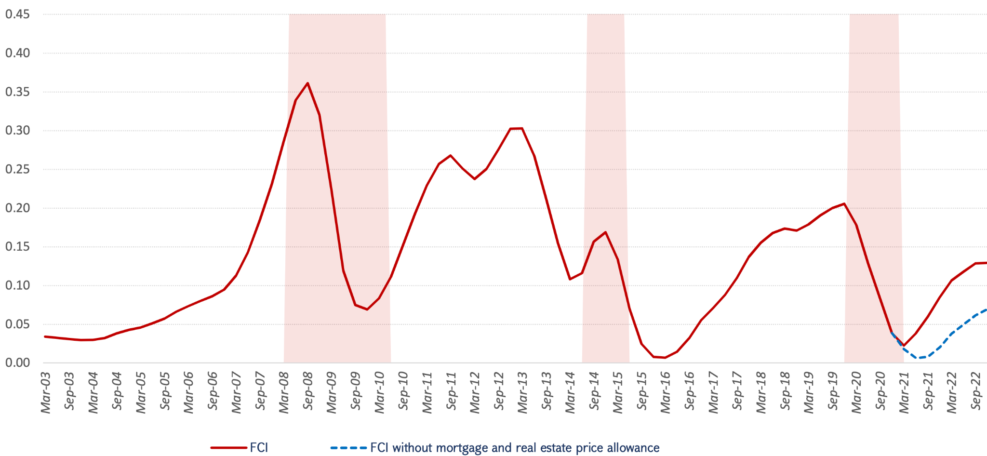
Relevance of financial cycles
Stable phase/Recovery:
CCyB at its neutral rate
Expansion and Peak:
CCyB above the neutral rate
Contraction:
CCyB released

Slide 6
Neutral rate
Neutral rate at CBA:
Rate applicable from May 2023: 1.0% (current rate)
Rate applicable from August 2023: 1.5% (positive neutral rate)
Reasons for maintaining a positive neutral rate:
Due to the risk of using the CCyB too early or late (inaction bias).
It temporally distributes the accumulation of buffers to be created in the future over a longer period of time (cost averaging).

Slide 7
Neutral rate estimation methodology
The rate is derived using stress tests, where the accumulated buffer is compared with losses recorded after the shock. The natural rate is then determined based on the missing capital in the scenario(s).
Steps:
A set of comparable scenarios generated for real GDP growth and exchange rate for the next 3-year horizon (500 scenarios using the Multivariate Gaussian copula method).
For each scenario, the probability of default was calculated according to individual banks, sectors, and currency.
The difference between the 95th quantile and the median of the resulting loss distribution was taken as an estimate of the CCyB neutral rate.

Slide 8
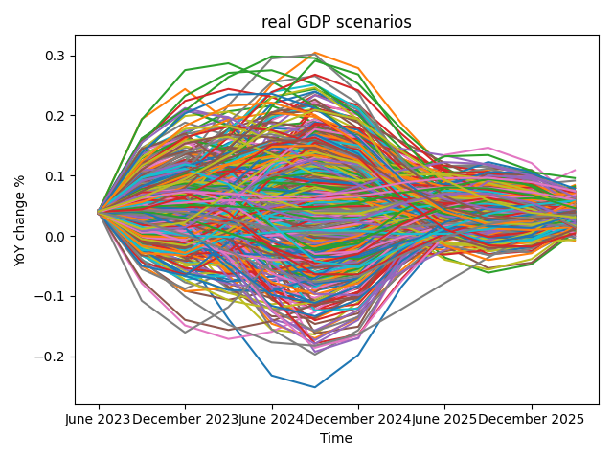
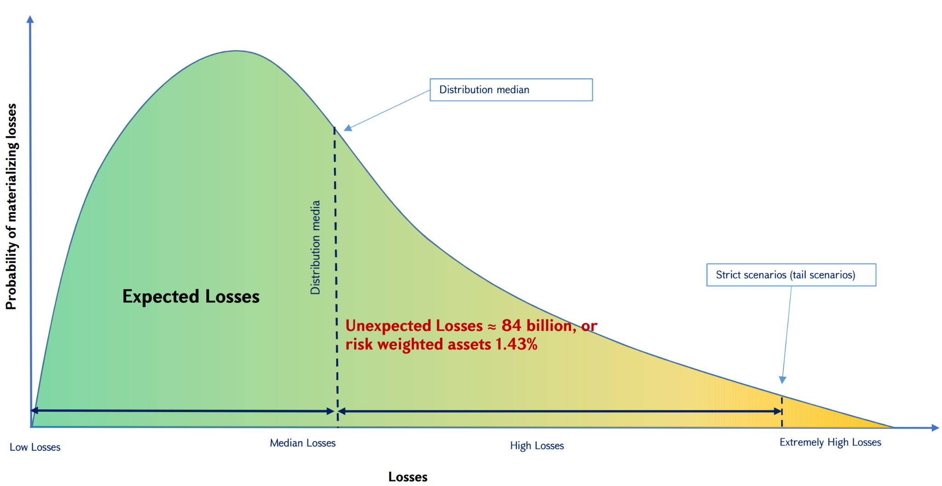
Neutral rate estimation
Estimated losses: 1.43% of RWA

Slide 9
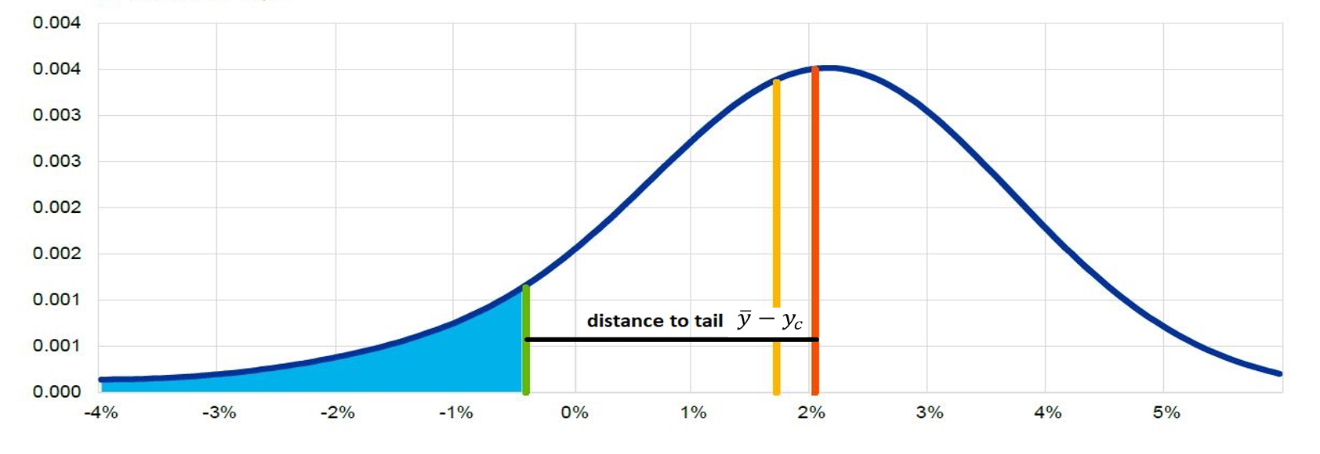
Compliments to CCyB framework
Main criticism to CCyB:
short-term costs
uncertainties concerning long-term benefits
Solution:
Quantify uncertainty by capturing the effects of policy on the entire distribution of GDP using the Growth at Risk (GaR) framework.
optimal rate is a result between the distance to tail and the mean

Slide 10
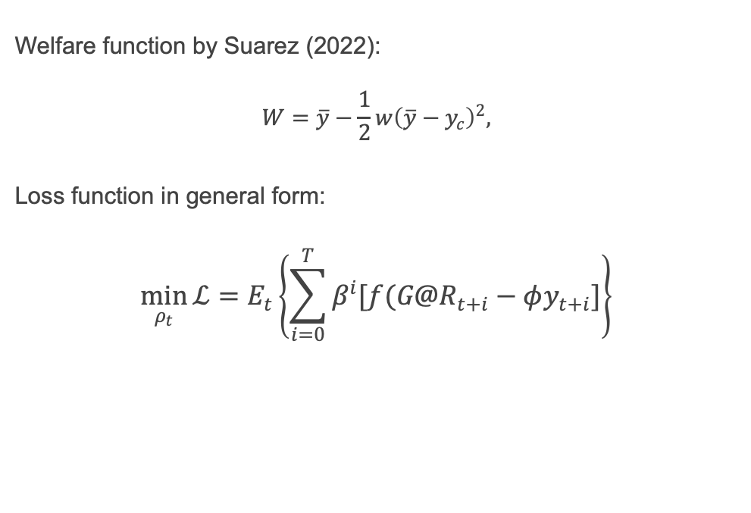
GaR Loss Function
Welfare function by Suarez (2022):
$$W=\overline{y}−\frac{1}{2}w{\left(\overline{y}−y_{c}\right)}^{2},$$
Loss function in general form:
$$\min_{ρ_{t}}{\text{ℒ}}=E_{t}\left\{\sum_{i=0}^{T}{β^{i}[f(G@R_{t+i}−φy_{t+i}]}\right\}$$

Slide 11
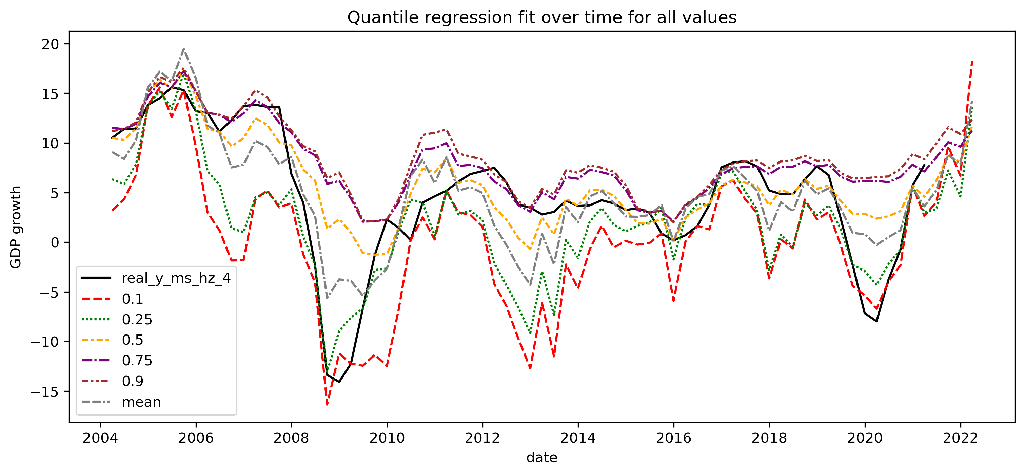
GaR WIP

Slide 12
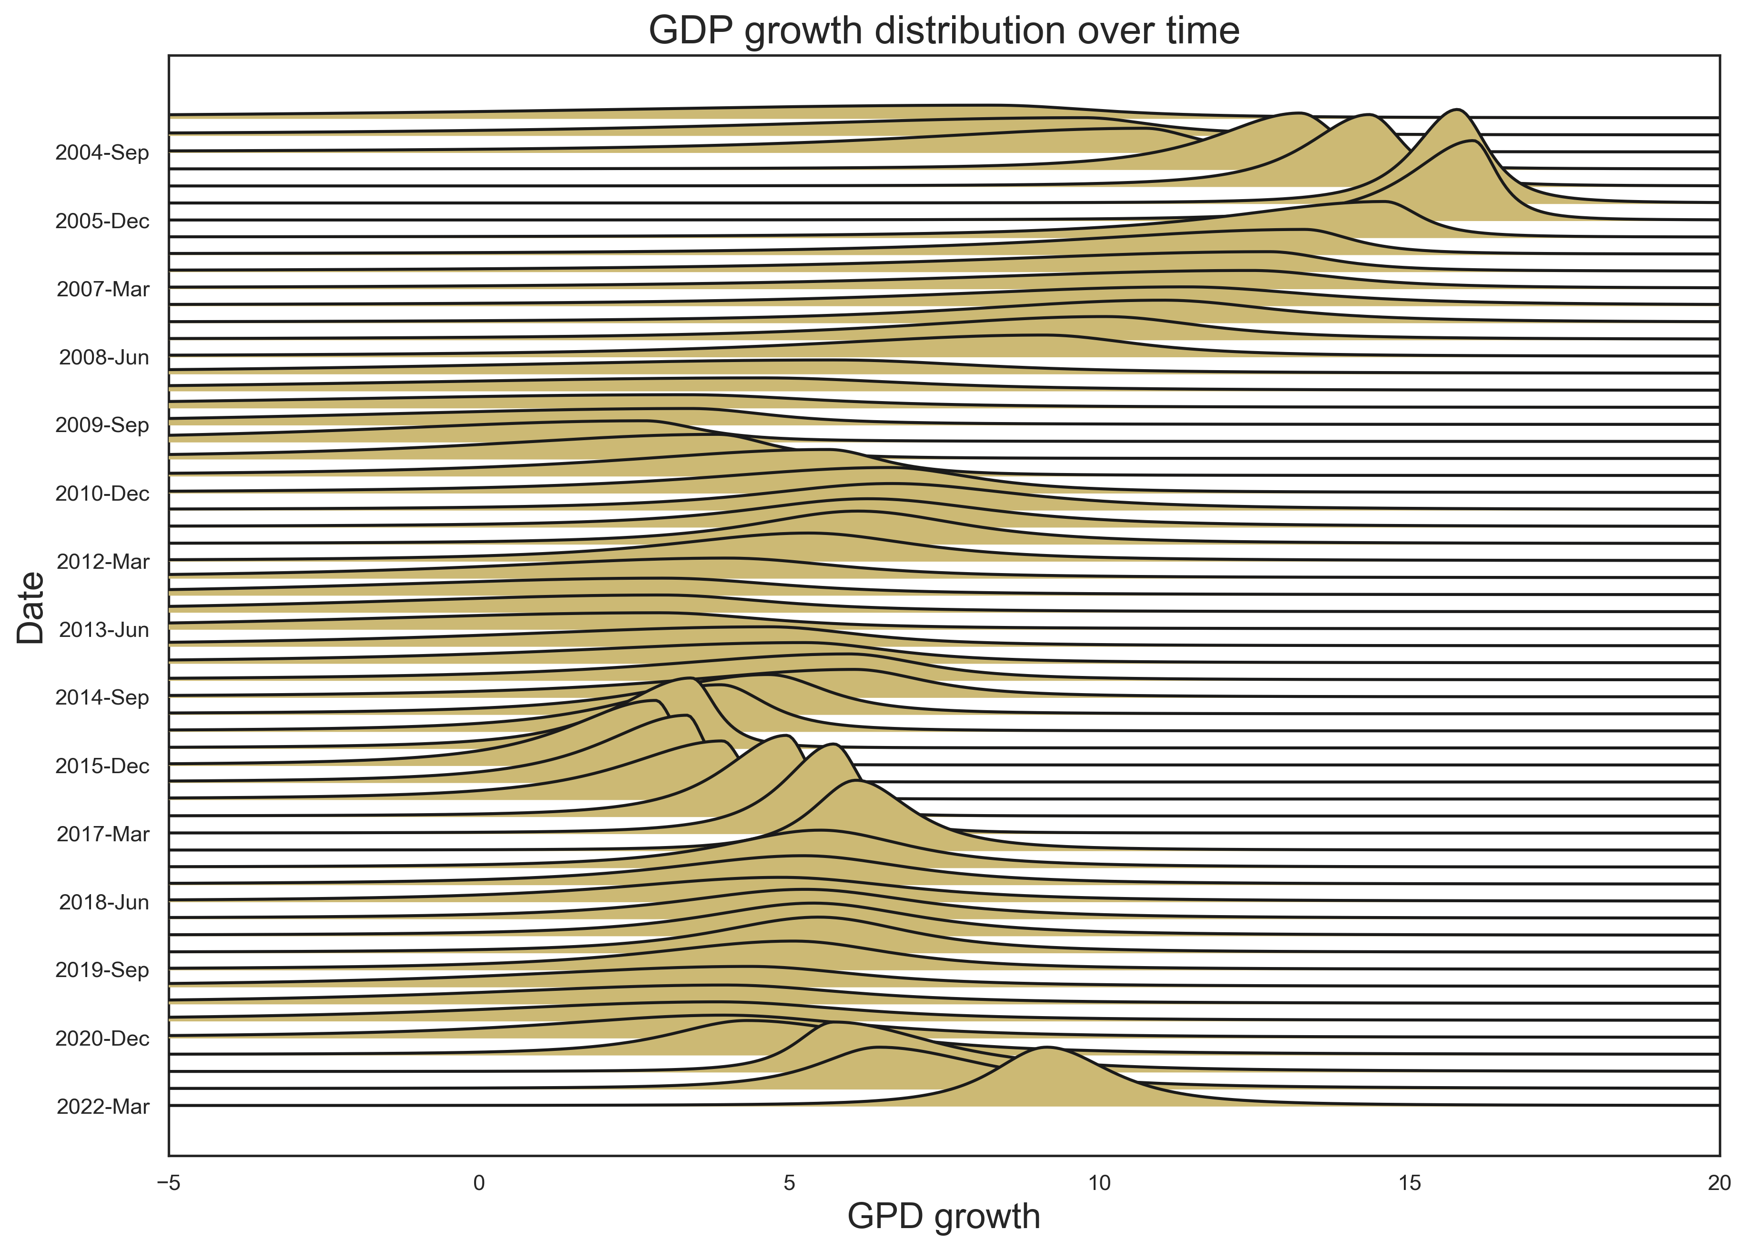
GaR WIP

Slide 13
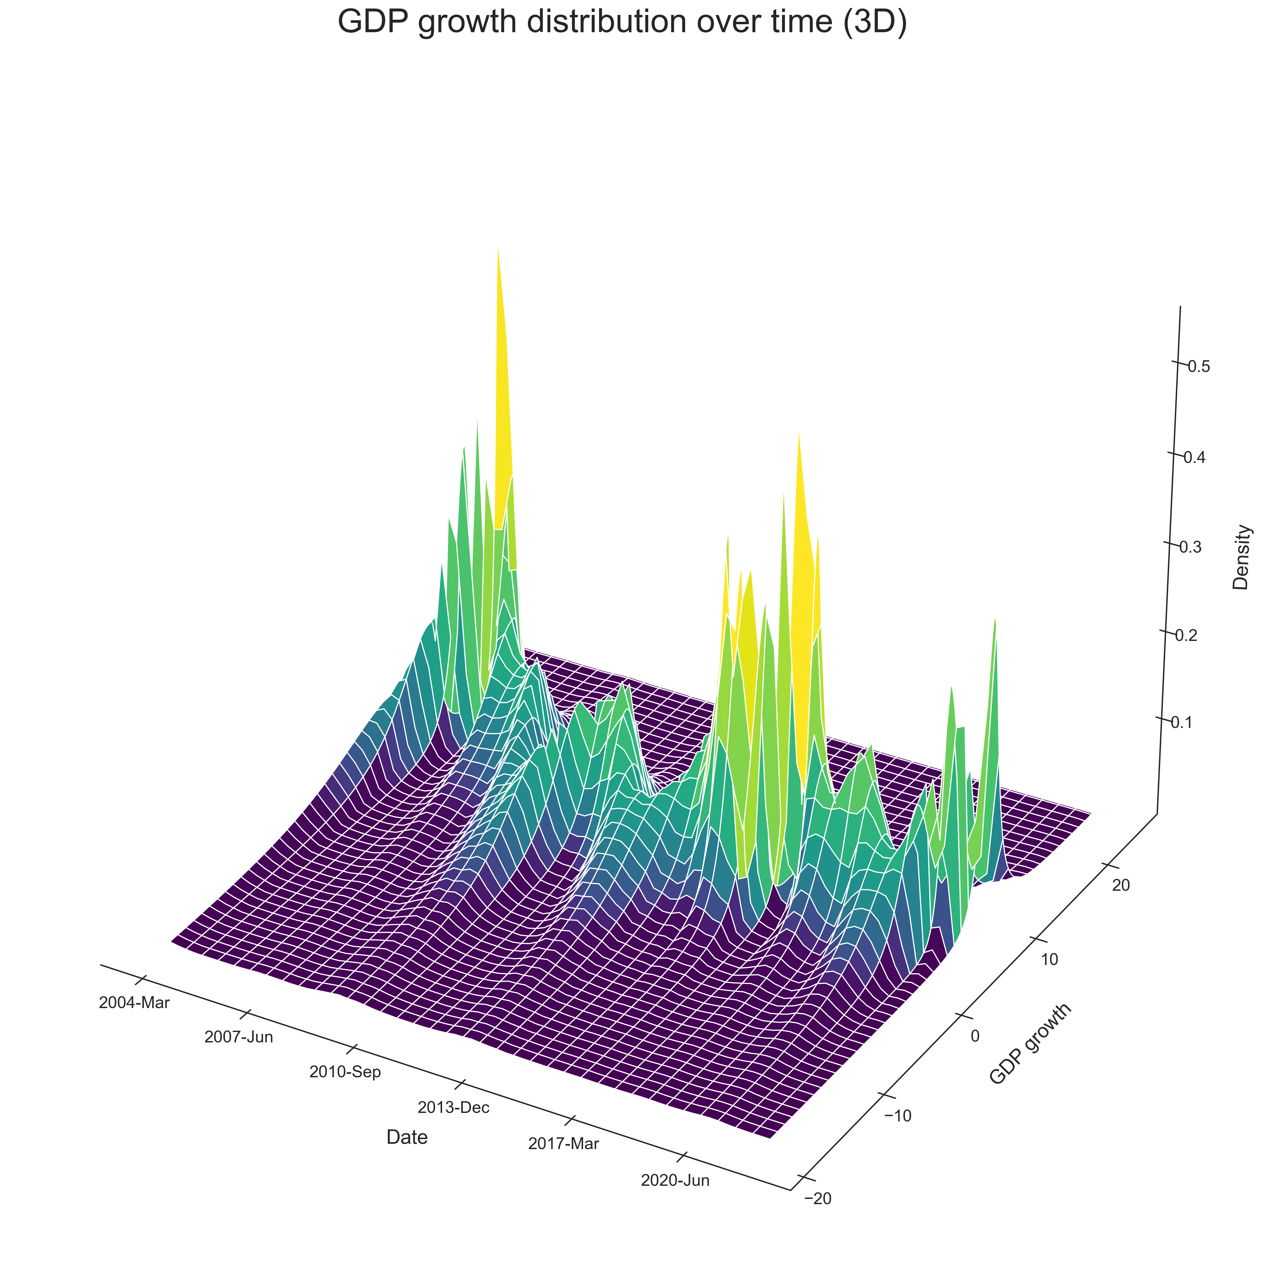
GaR WIP

Slide 14
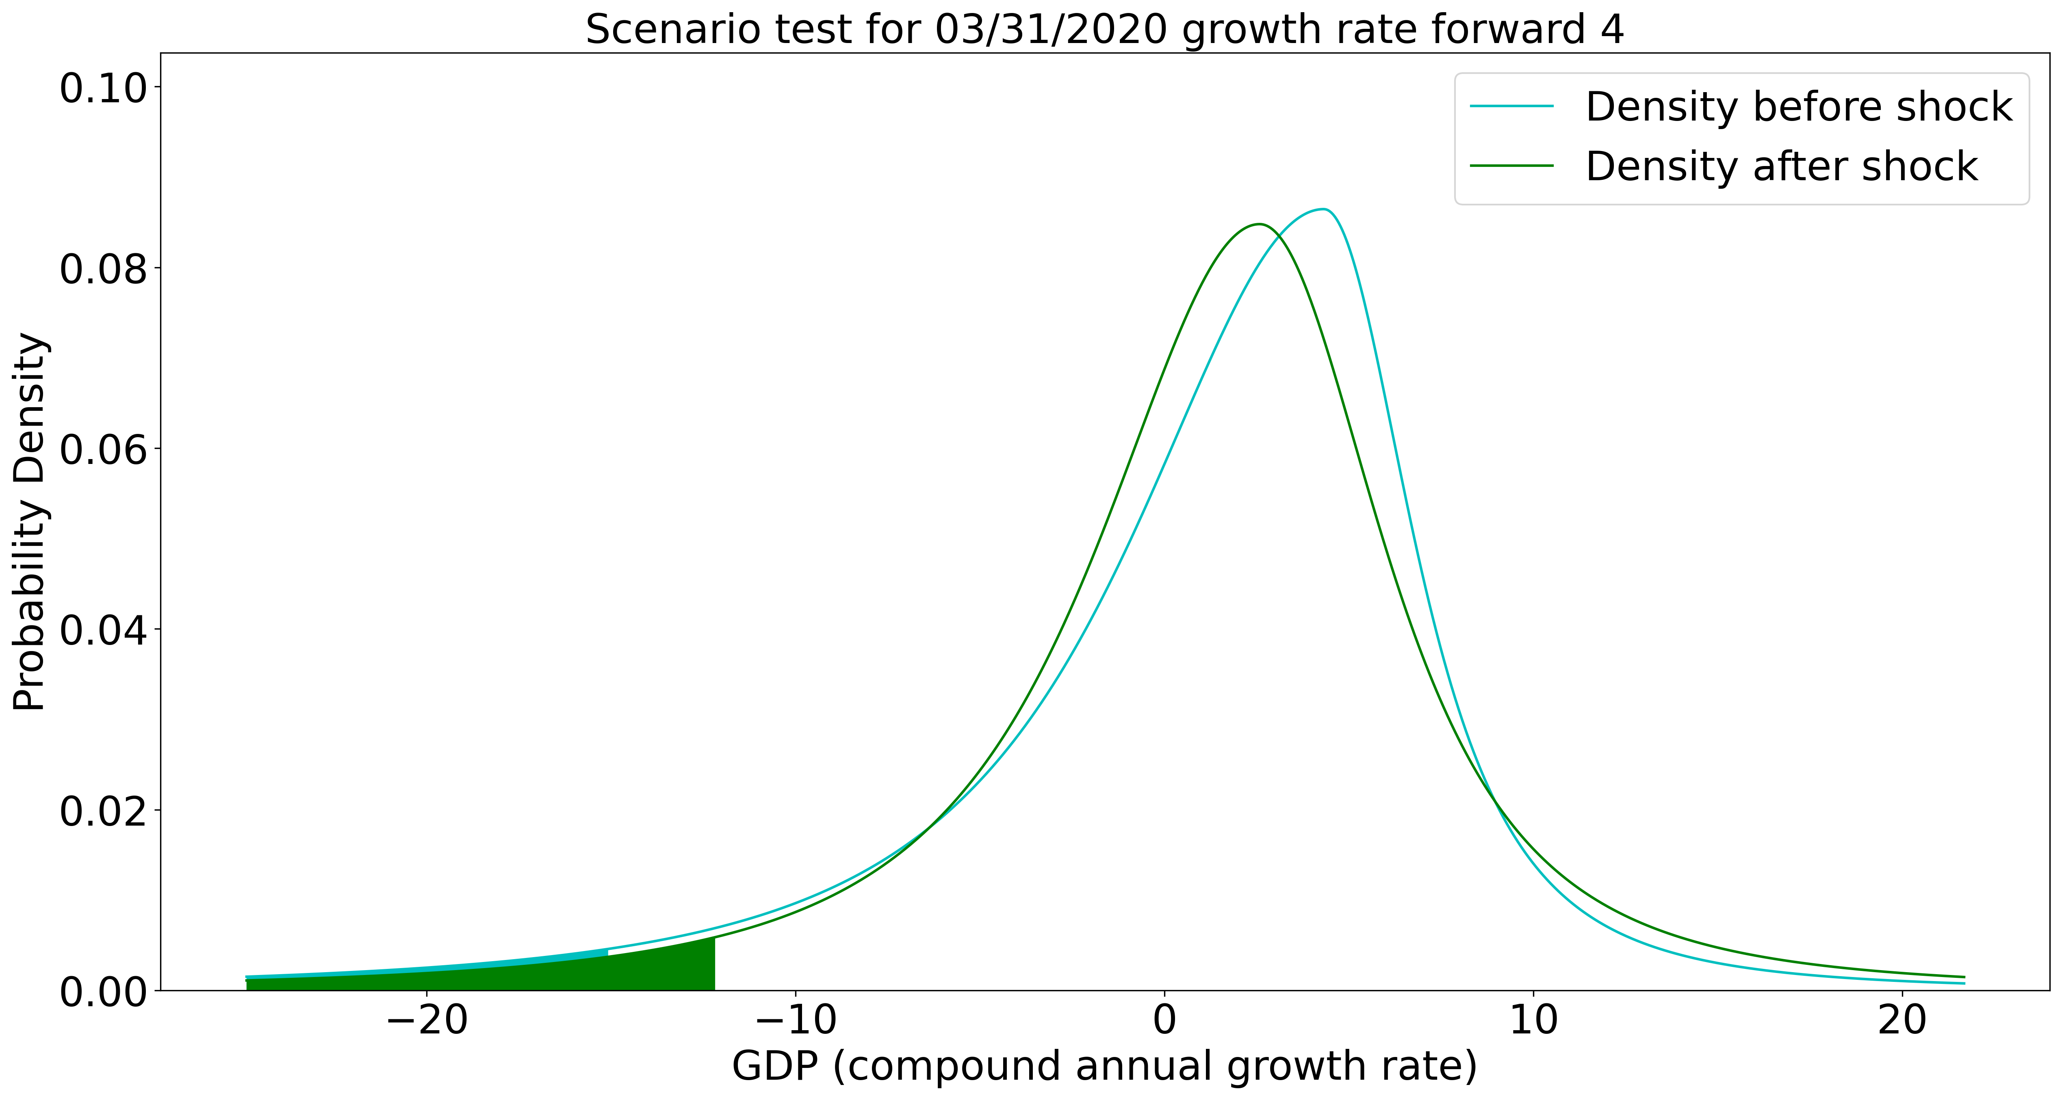
GaR WIP

Slide 15
Forward-looking policy
Rule based decision making framework:
Stable phase of cycle: neutral rate
Expansion and Peak of cycle: optimal rate based on GaR
Contraction: release

Slide 16
Thank you

Slide 17
Appendix 1: 2009 CCyB backward scenario analysis

Slide 18
Appendix 1: 2014 CCyB backward scenario analysis

Slide 19
Appendix 1: 2020-21 CCyB backward scenario analysis

